Slide 1


MAPREDUCE

Slide 2
Hadoop Mapreduce paradigm
Hadoop is an open-source software framework for storing and processing large datasets ranging in size from gigabytes to petabytes.
developed at the Apache Software Foundation.
basically two components in Hadoop:
1. Massive data storage
2. Faster data processing

Slide 3
Hadoop Mapreduce paradigm
Hadoop distributed File System (HDFS):
It allows you to store data of various formats across a cluster.
Map-Reduce:
For resource management in Hadoop. It allows parallel processing over the data stored across HDFS.

Slide 4
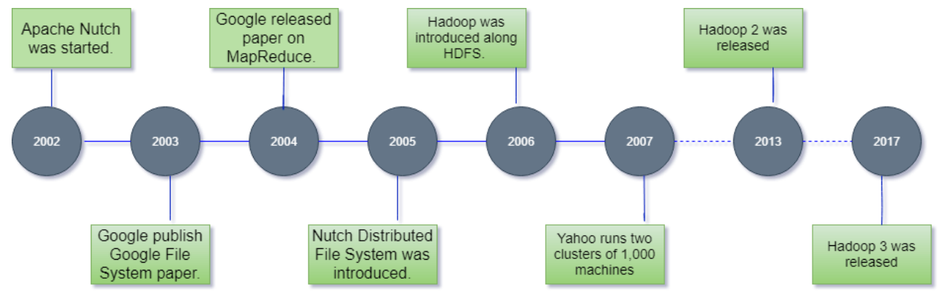
History of Hadoop

Slide 5
Why Hadoop?
Cost Effective System
Computing power
Scalability
Storage flexibility
Inherent data protection
Varied Data Sources
Fault-Tolerant
Highly Available
Low Network Traffic
High Throughput
Multiple Languages Supported

Slide 6
Disadvantages of Hadoop
Issue With Small Files
Vulnerable By Nature
Processing Overhead
Supports Only Batch Processing
Iterative Processing
Security

Slide 7
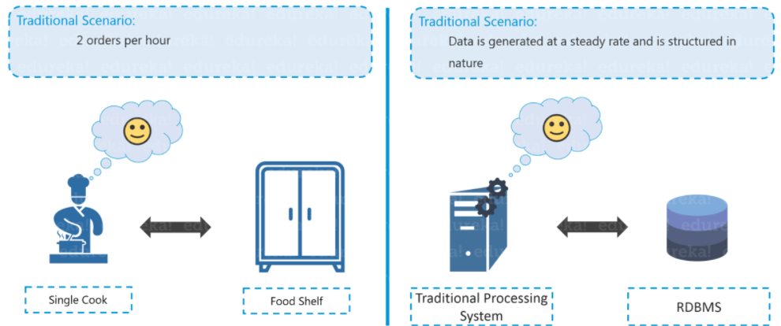

Traditional restaurant scenerio

Slide 8
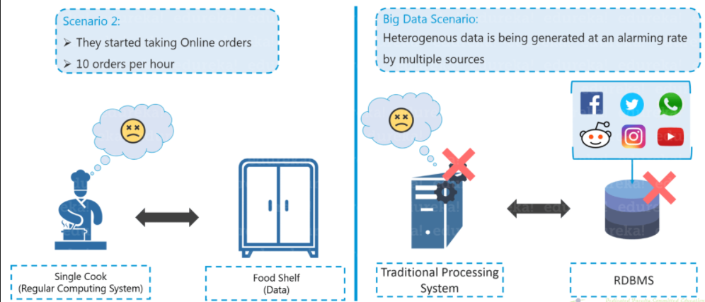
Traditional Scenario

Slide 9
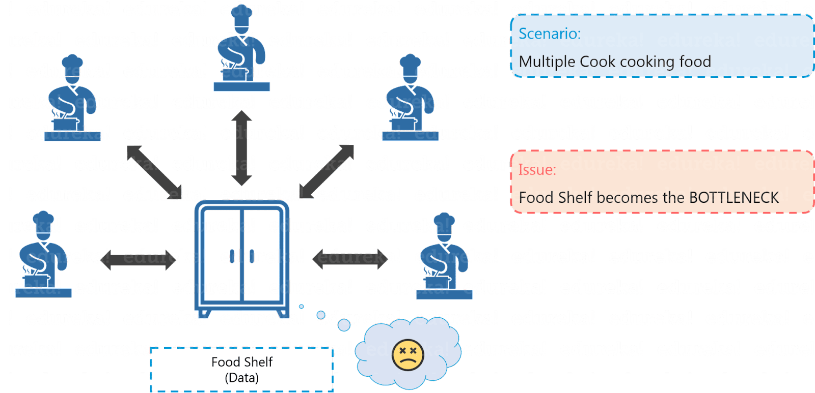
Distributed Processing Scenario

Slide 10
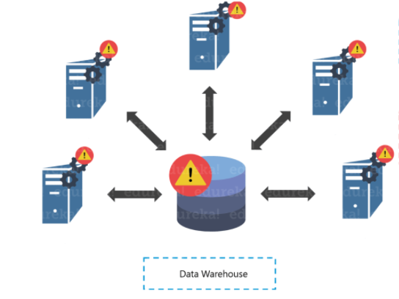
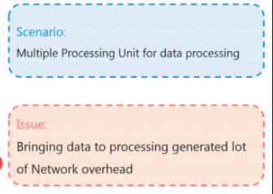
Distributed Processing Scenario Failure

Slide 11
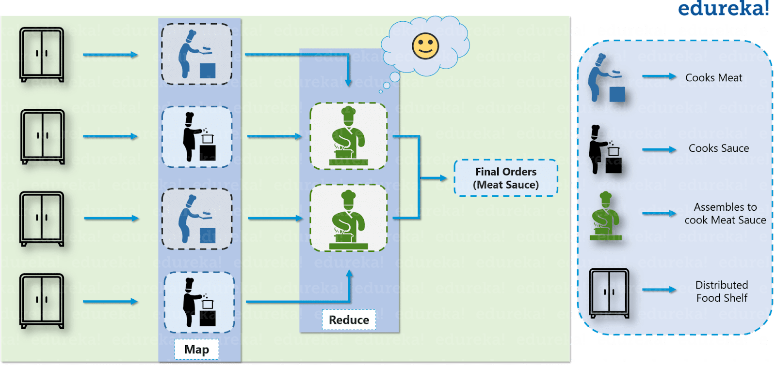
Solution of Restaurant problem

Slide 12
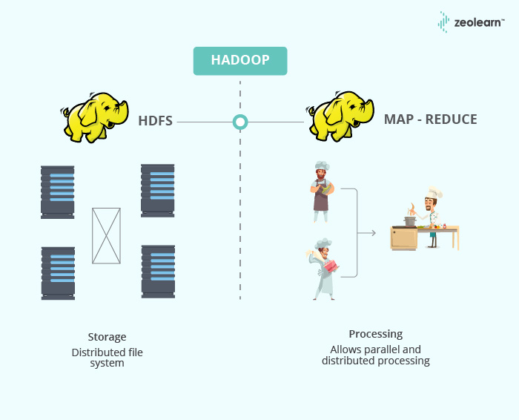
Hadoop in Restaurant Analogy

Slide 13
Map tasks
Process independent chunks in a parallel manner
Out of map task stored as intermediate data on local disk of that server
Reduce task
Out of mapper automatically shuffled and stored by framework
Sorts the output based on key
Provide reduced output by combining the output f various mappers

Slide 14
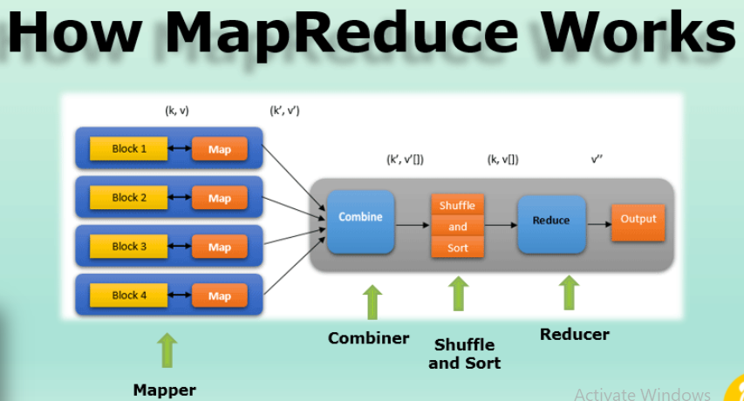

Slide 15
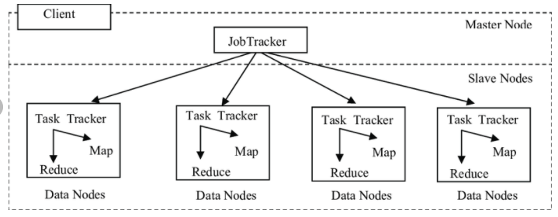
Map-reduce daemons
JobTrackers
TaskTrackers

Slide 16
JobTracker
Master daemon
Single JobTracker per Hadoop cluster
Provide connectivity between Hadoop and client application
Execution plan creation(which task to assign to which node)
Monitor all running tasks
If task failed then rescheduling

Slide 17
Task Tracker
Responsible for executing individual task which is assigned by JobTracker
Single Task Tracker per slave
Continuously sends heartbeat message to Job Tracker
If no heartbeat message then task will be allocated to other Task Trackers

Slide 18
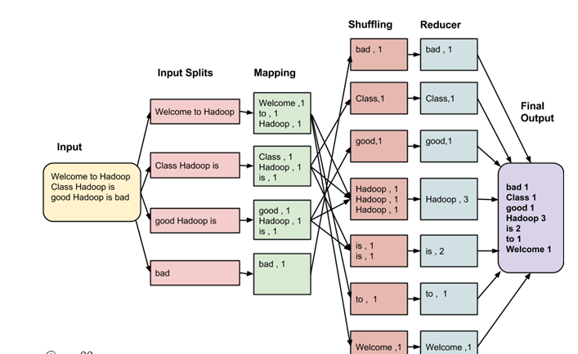
Map-reduce execution pipeline

Slide 19
Mapper
Mapper maps the input key-value pairs into a set of intermediate key-value pairs
Phases:
RecordReader:
Converts tasks with key value pairs
<Key , value> → <positional information, chunk of data that constitutes the record>
2. Map:
generate zero or more intermediate key-value pairs

Slide 20
Mapper
3. Combiner
Optimization technique for mapreduce job, applies user specific aggregate function to only that mapper
Also known as Local reducer
4. Partitioner
Intermediate key-value pairs
Usually Number of partitions are equal to the number of reducer

Slide 21
Reducer
Shuffle and sort:
consumes the output of Mapping phase
consolidate the relevant records from Mapping phase output.
the same words are clubbed together along with their respective frequency.

Slide 22
Reducer
2. Reducer:
Grouped data produced by the shuffle and sort phase
Apply reduce function
Process one group at a time
Reducer function iterate all the values associated with that key
Aggregation, filtering,combining
3. Output format:
Separates key value pair with tab
Write it out to a file using record writer

Slide 23
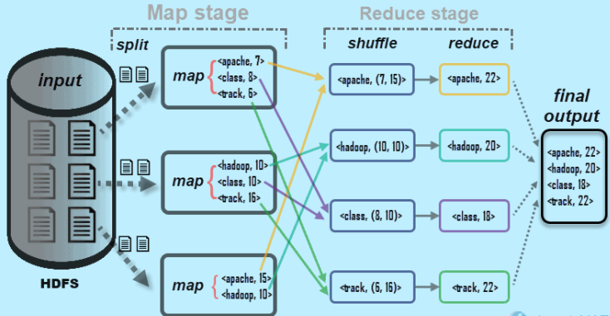

Slide 24
API(Application programming interface)
Main Class file Packages
Mapper Class Packages
Reducer Class Packages

Slide 25
Main class file packages
import org.apache.hadoop.conf.Configured; (Configuration of system parameters)
import org.apache.hadoop.fs.Path; (Configuration of file system path)
import org.apache.hadoop.io.IntWritable; (Input/output package to display in output screen)
import org.apache.hadoop.io.Text; ( to read and write the text)
import org.apache.hadoop.mapred.FileInputFormat; ( MapRed file input format)
import org.apache.hadoop.mapred.FileOutputFormat; ; ( MapRed file output format)
import org.apache.hadoop.mapred.JobClient; ( assign the input job and process)
import org.apache.hadoop.mapred.JobConf; (configuration file to execute I/O process)

Slide 26
import org.apache.hadoop.util.Tool; (interface (command line options) used to access MapRed functions)
import org.apache.hadoop.util.ToolRunner;
( Interface use to call run function)

Slide 27
Mapper File Packages
import java.io.IOException; ( Exception handle)
import org.apache.hadoop.io.IntWritable; ( to read the integer file)
import org.apache.hadoop.io.LongWritable; (to read files range exceeding integer)
import org.apache.hadoop.io.Text; (Input and output text)
import org.apache.hadoop.mapred.MapReduceBase;( Inherited class of MapReduce functions)
import org.apache.hadoop.mapred.Mapper; (Mapper Class)
import org.apache.hadoop.mapred.OutputCollector; ( to collect and display class)
import org.apache.hadoop.mapred.Reporter; (to display the information)

Slide 28
Reducer file Package
import java.io.IOException; ( Exception handle)
import java.util.Iterator; (to call utility function has more elements from iterator class)
import org.apache.hadoop.io.IntWritable; ( to read the integer file)
import org.apache.hadoop.io.Text; (Input and output text)

Slide 29
Reducer file Package
import org.apache.hadoop.mapred.MapReduceBase; ( Inherited class of MapReduce functions)
import org.apache.hadoop.mapred.OutputCollector; ( to collect and display class)
import org.apache.hadoop.mapred.Reducer; (Reducer Class)
import org.apache.hadoop.mapred.Reporter; (to display the information)

Slide 30
Hadoop 2.0 features
HDFS Federation – horizontal scalability of NameNode
NameNode High Availability – NameNode is no longer a Single Point of Failure
YARN – ability to process Terabytes and Petabytes of data available in HDFS using Non-MapReduce applications such as MPI, GIRAPH

Slide 31
Hadoop 2.0 features
Resource Manager – splits up the two major functionalities of overburdened JobTracker (resource management and job scheduling/monitoring) into two separate daemons: a global Resource Manager and per-application ApplicationMaster
Capacity Scheduler
Data Snapshot
Support for Windows

Slide 32
Namenode high availability
Hadoop 1.x, NameNode was single point of failure
Hadoop Administrators need to manually recover the NameNode using Secondary NameNode.
Hadoop 2.0 Architecture supports multiple NameNodes to remove this bottleneck
Passive Standby NameNode support.
In case of Active NameNode failure, the passive NameNode becomes the Active NameNode and starts writing to the shared storage

Slide 33
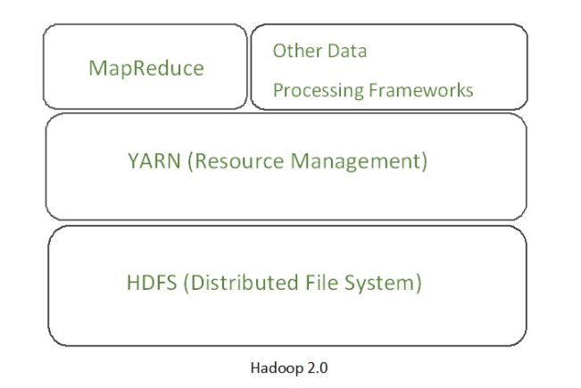
YARN(Yet Another Resource Negotiator)
Main idea is splitting the JobTracker responsibility of resource management and Job scheduling into separate daemons.

Slide 34
YARN daemons
Global resource manager:
Scheduler(allocation of resources among various running applications)
Application manager(Accepting job submission, restarting application master in case of failure)

Slide 35
YARN daemons
2. Node manager:
Pre machine slave daemon
Launching application container for application execution
Report usage of resources to the global resource manager

Slide 36
YARN daemons
3. Application master:
Application specific entity
Negotiate required resources for execution from the resource manager
Works with node manager for executing and monitoring component tasks

Slide 37
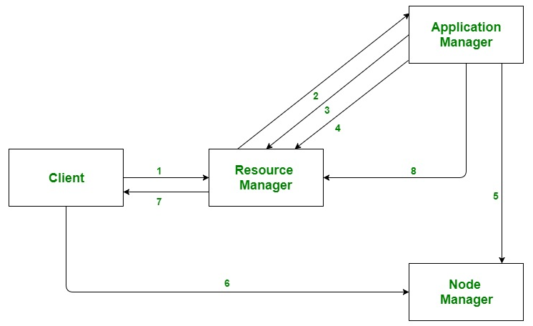
YARN

Slide 38
YARN workflow
Client submits an application
The Resource Manager allocates a container to start the Application Manager
The Application Manager registers itself with the Resource Manager
The Application Manager negotiates containers from the Resource Manager
The Application Manager notifies the Node Manager to launch containers
Application code is executed in the container
Client contacts Resource Manager/Application Manager to monitor application’s status
Once the processing is complete, the Application Manager un-registers with the Resource Manager

Slide 39


